Slide 1


Parker Jackson
5/24/22

Slide 2

Outline
Executive Summary
Introduction
Methodology
Results
Conclusion
Appendix

Slide 3
Executive Summary
Summary of methodologies
Data Collection through API
Data Collection through Web Scraping
Data Wrangling
Exploratory Data Analysis with SQL
Exploratory Data Analysis with Data Visualization
Interactive Visual Analytics with Folium
Summary of all results
Exploratory Data Analysis results
Machine Learning Prediction results

Slide 4
Introduction
SpaceX has a cost advantage over its competitors because it has reusable first stage rockets like the Falcon 9.
Can we use data collected on the internet to predict the successful recovery rate of the reusable rockets?

Slide 5

Section 1

Slide 6
Methodology
Executive Summary
Data collection methodology:
The data was scraped from the internet using the SpaceX API
Perform data wrangling
The data was put into a Pandas data frame with each column given a proper label
Perform exploratory data analysis (EDA) using visualization and SQL
Perform interactive visual analytics using Folium and Plotly Dash
Perform predictive analysis using classification models
The data was split into test and training datasets put through a grid search to pick the best tuning parameters to predict and fit multiple classification models

Slide 7
Data Collection
The data was collected through a SpaceX Rest API and scraped from the internet
Python was used with the Pandas library to populate Dataframes using the data collected

Slide 8
Data Collection – SpaceX API
https://github.com/parksandrecs/solid-dollop/blob/d9e83f40099f048e0f8a67e6f6d9ce0e791ce7b8/jupyter_labs_spacex_data_collection_api.ipynb
Rest API
Raw Data Pulled
Filtered Down to Falcon9 Data
DataFrame

Slide 9
Data Collection - Scraping
https://github.com/parksandrecs/solid-dollop/blob/aceecde4bfdc149959e012f81bab68ef9d71aeb0/jupyter_labs_webscraping.ipynb
Wikipedia URL
Raw Data Scraped
HTML Table
DataFrame

Slide 10
Data Wrangling
DataFrame created
Check for Missing Values and Data Types
Calculate Missing Values
FinalDataFrame
Create Feature Label
https://github.com/parksandrecs/solid-dollop/blob/d9e83f40099f048e0f8a67e6f6d9ce0e791ce7b8/labs_jupyter_spacex_Data_wrangling.ipynb

Slide 11
EDA with Data Visualization
I graphed the relationship between flight number, payload weight, and the success rate
https://github.com/parksandrecs/solid-dollop/blob/d9e83f40099f048e0f8a67e6f6d9ce0e791ce7b8/jupyter_labs_eda_dataviz.ipynb

Slide 12
EDA with SQL
The queries found
the launch site names
Total payload weight carried by NASA(CRS) missions
Average payload carried by booster version F9 v1.1
Total number of missions by grouped by outcome type
Failures by drone ship and the details of the mission
https://github.com/parksandrecs/solid-dollop/blob/d9e83f40099f048e0f8a67e6f6d9ce0e791ce7b8/sql_eda.ipynb

Slide 13
Build an Interactive Map with Folium
The interactive map has a marker for every launch site
Each launch site has a green marker for every successful mission and a red marker for every failure
There is a measurement line from the eastern most launch site to the nearest coastline
https://github.com/parksandrecs/solid-dollop/blob/d9e83f40099f048e0f8a67e6f6d9ce0e791ce7b8/lab_jupyter_launch_site_location%20(1).ipynb

Slide 14
Build a Dashboard with Plotly Dash
I included pie charts representing success rate by launch site to show the relationship between the two
I included a scatter plot to show the relationship between the payload weight and the success rate
https://github.com/parksandrecs/solid-dollop/blob/d9e83f40099f048e0f8a67e6f6d9ce0e791ce7b8/Dashboard.py

Slide 15
Predictive Analysis (Classification)
Choose Outcome and Features
Scale the Features
Train-Test Split
Fit Testing set and Measure Accuracy
Use GridSearchCv to Optimize Parameters and Fit Training Set
Choose Best Model
https://github.com/parksandrecs/solid-dollop/blob/d9e83f40099f048e0f8a67e6f6d9ce0e791ce7b8/SpaceX_Machine_Learning_Prediction_Part_5.ipynb

Slide 16
Results
Exploratory data analysis results
Interactive analytics demo in screenshots
Predictive analysis results

Slide 17

Section 2

Slide 18
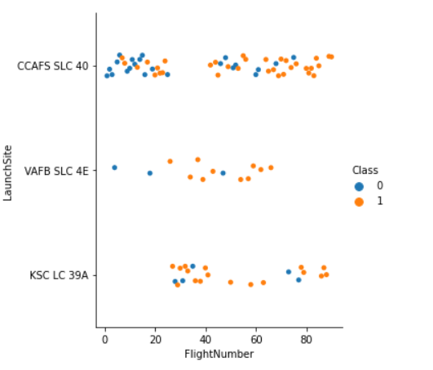
Flight Number vs. Launch Site
Blue dots show rocket recovery failures while orange shows successes
SpaceX has improved its recovery success rate over time

Slide 19
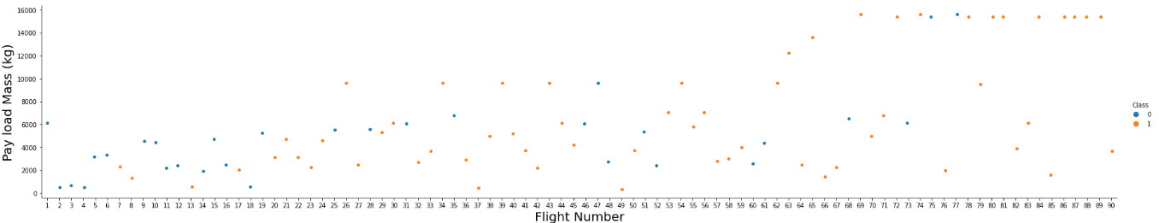
Payload vs. Launch Site
Blue dots show rocket recovery failures while orange shows successes
We see that as the flight number increases, the first stage is more likely to land successfully. The payload mass is also important; it seems the more massive the payload, the less likely the first stage will return.

Slide 20
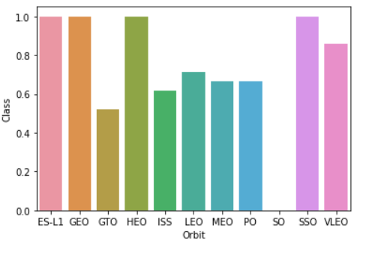
Success Rate vs. Orbit Type
Orbit types affect success rate
ES-L1, GEO, HEO, and SSO have the highest success rate

Slide 21
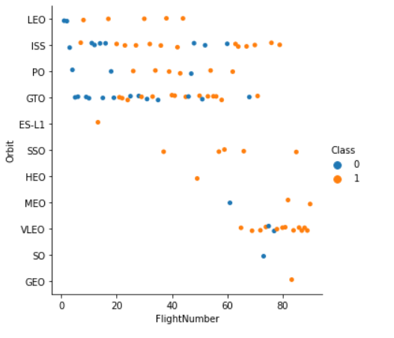
Flight Number vs. Orbit Type
Blue dots show rocket recovery failures while orange shows successes
You should see that in the LEO orbit the Success appears related to the number of flights; on the other hand, there seems to be no relationship between flight number when in GTO orbit

Slide 22
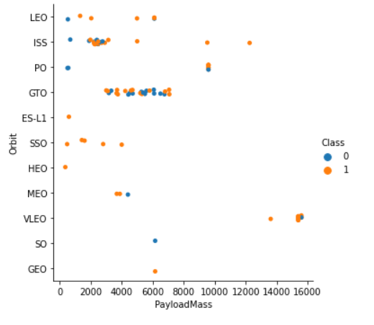
Payload vs. Orbit Type
Blue dots show rocket recovery failures while orange shows successes
With heavy payloads the successful landing or positive landing rate are more for Po, LEO, and ISS. However, for GTO we cannot distinguish this well as both positive landing rate and (unsuccessful mission) are both there here

Slide 23
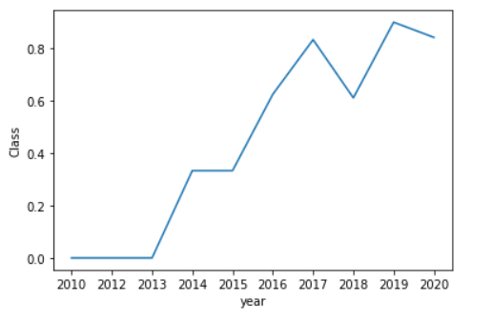
Launch Success Yearly Trend
You can observe that the success rate since 2013 kept increasing till 2020

Slide 24
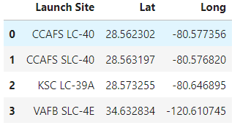
All Launch Site Names
Here is a list of all the unique launch sites that SpaceX uses

Slide 25
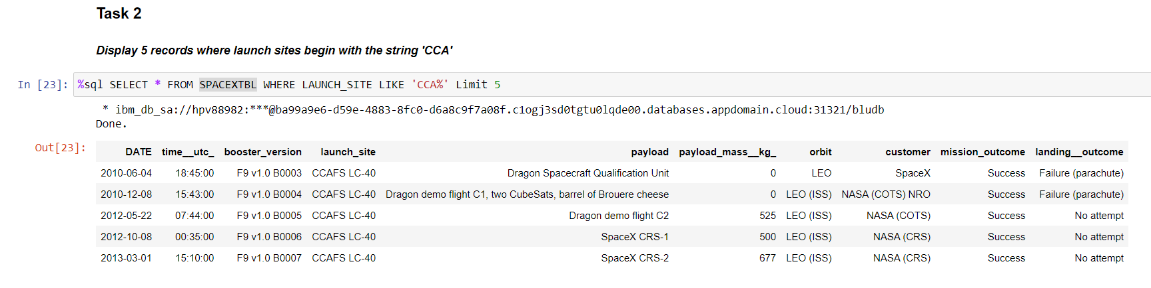
Launch Site Names Begin with 'CCA'
Find 5 records where launch sites begin with `CCA`
Present your query result with a short explanation here

Slide 26
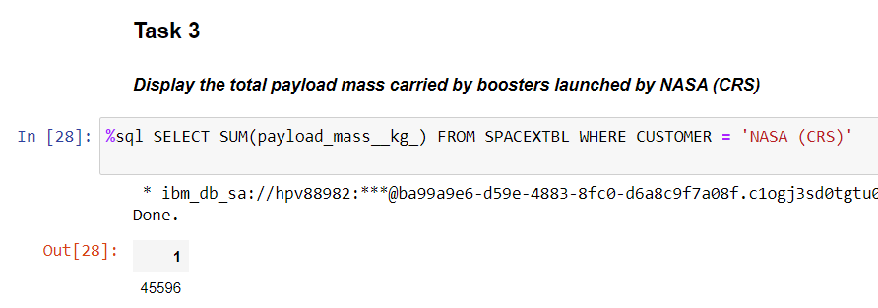
Total Payload Mass
Calculate the total payload carried by boosters from NASA
Present your query result with a short explanation here

Slide 27
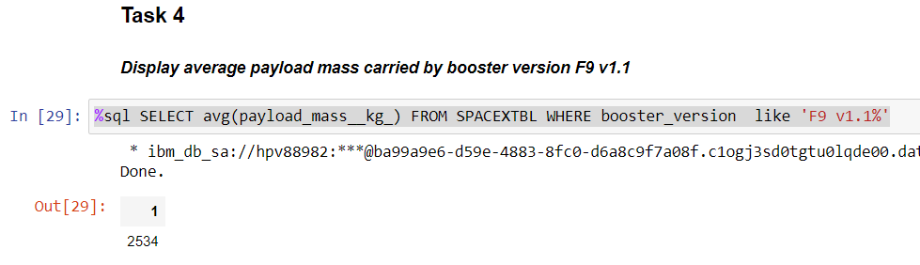
Average Payload Mass by F9 v1.1
Calculate the average payload mass carried by booster version F9 v1.1
Present your query result with a short explanation here

Slide 28
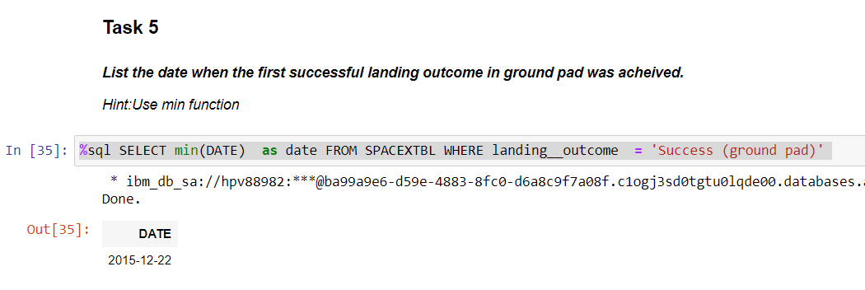
First Successful Ground Landing Date
Find the dates of the first successful landing outcome on ground pad
Present your query result with a short explanation here

Slide 29
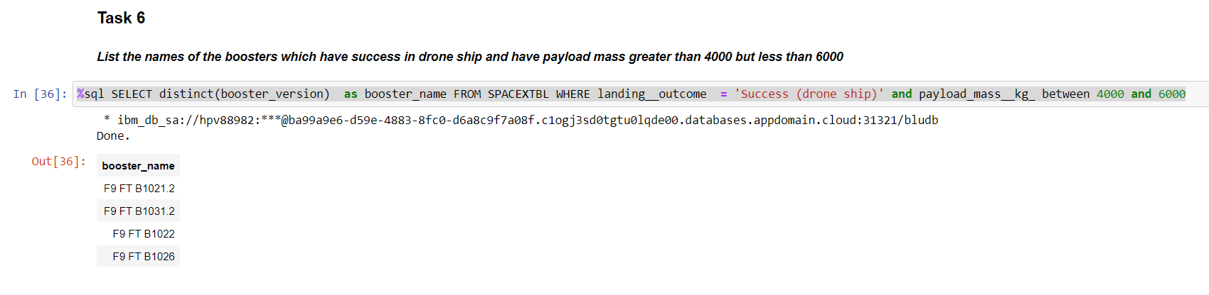
Successful Drone Ship Landing with Payload between 4000 and 6000
List the names of boosters which have successfully landed on drone ship and had payload mass greater than 4000 but less than 6000
Present your query result with a short explanation here

Slide 30
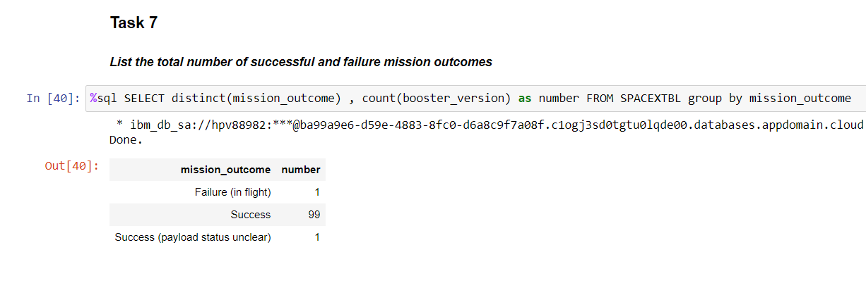
Total Number of Successful and Failure Mission Outcomes
Calculate the total number of successful and failure mission outcomes
Present your query result with a short explanation here

Slide 31
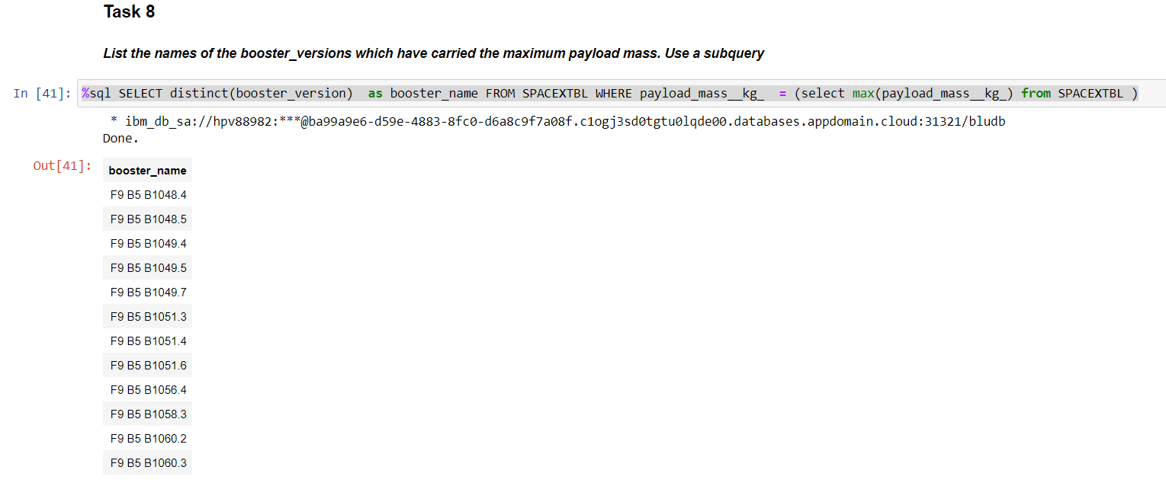
Boosters Carried Maximum Payload
List the names of the booster which have carried the maximum payload mass
Present your query result with a short explanation here

Slide 32
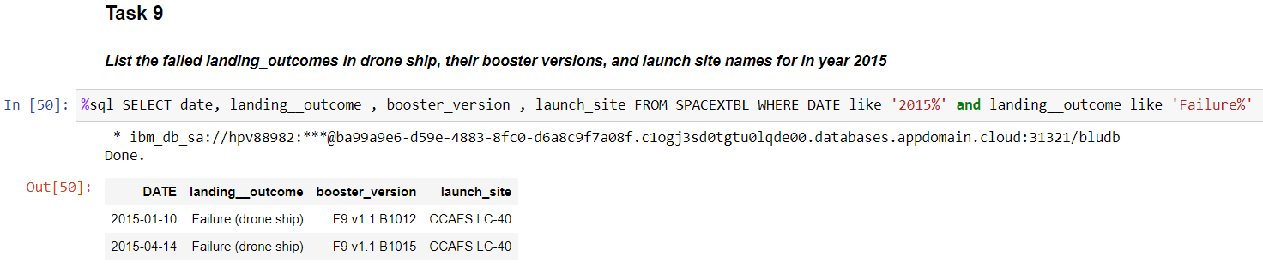
2015 Launch Records
List the failed landing_outcomes in drone ship, their booster versions, and launch site names for in year 2015
Present your query result with a short explanation here

Slide 33
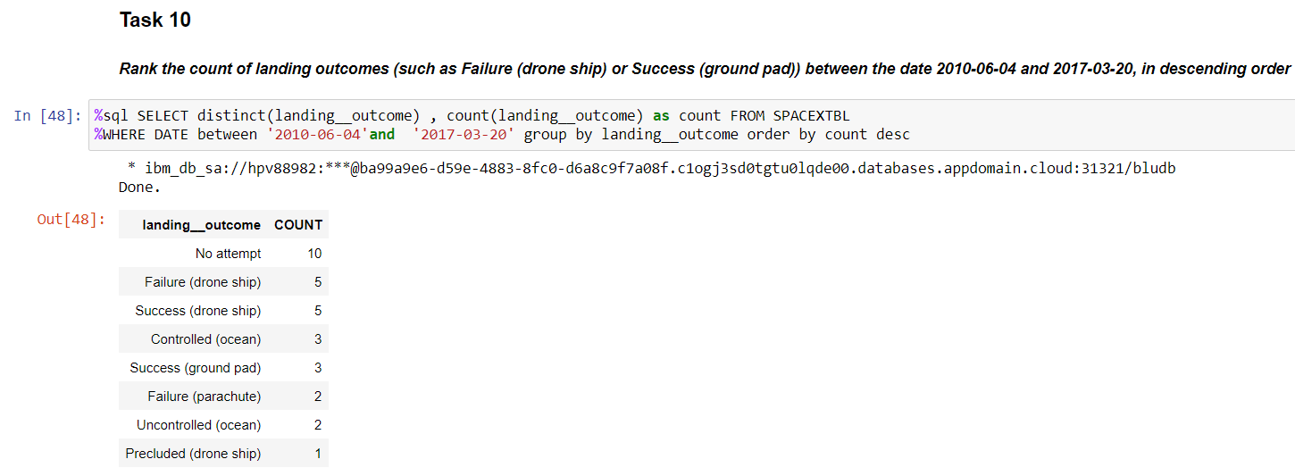
Rank Landing Outcomes Between 2010-06-04 and 2017-03-20
Rank the count of landing outcomes (such as Failure (drone ship) or Success (ground pad)) between the date 2010-06-04 and 2017-03-20, in descending order
Present your query result with a short explanation here

Slide 34

Section 3

Slide 35
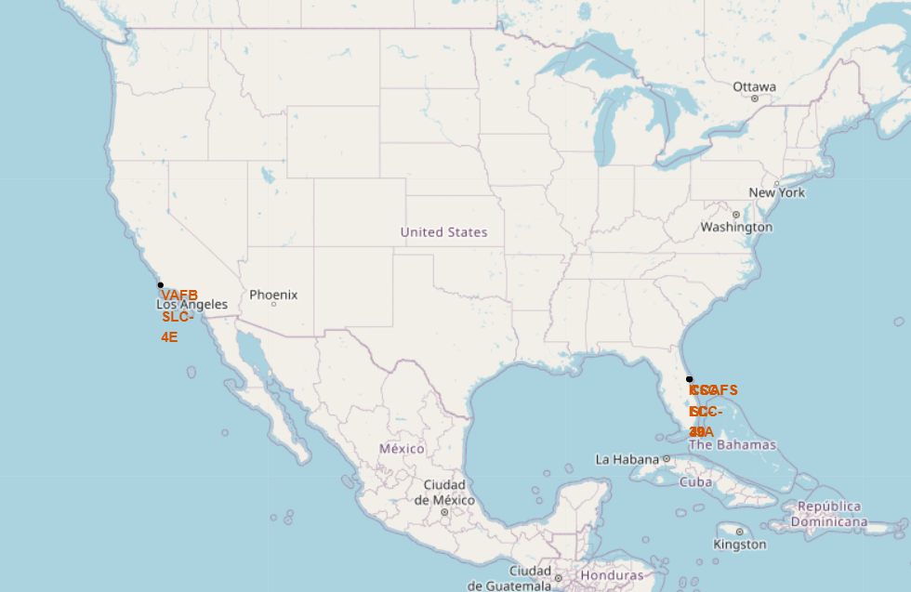
SpaceX Map of Launch Sites
There are four launch sites in total
The VAFB is on the west coast in southern California while the other three are on the east coast is northern Florida

Slide 36
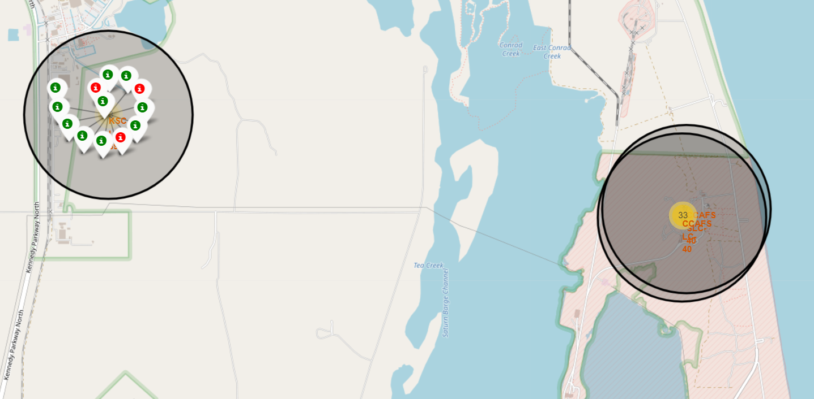
SpaceX Success and Failure Map
This is a close-up map of the three launch sites in Florida. Only the KSC LC-39A launch site is toggled to show the success and failure incidents.
The green markers represent successful recovery of a first stage rocket. The red represent failures.

Slide 37
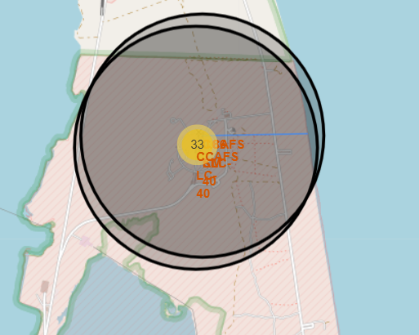
Distance Marker on Launch Site
This map shows a distance marker from the CCAFS SLC-40 launch site to the nearest coastline

Slide 38

Section 4

Slide 39
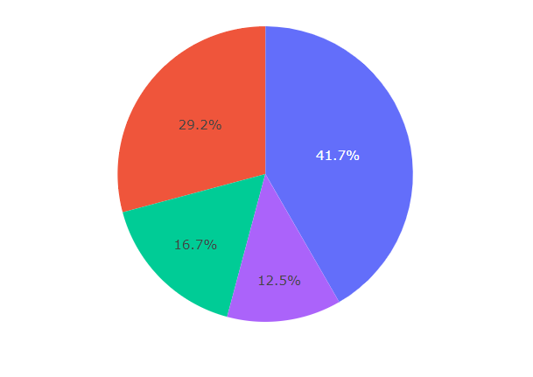
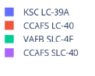
Success Rate of Launch Sites
This pie chart shows the recovery success rate for all SpaceX launch sites

Slide 40
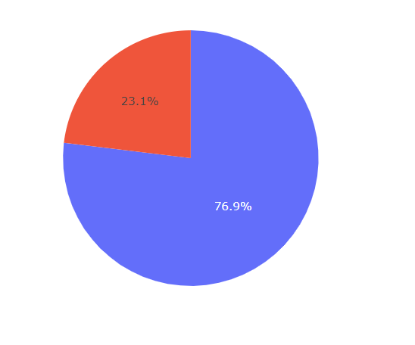
KSC LC-39A Success Rate
This pie chart shows KSC LC-39A’s recovery success rate, which is the highest of all the SpaceX launch sites.
Blue represents success rate, red is failure rate

Slide 41
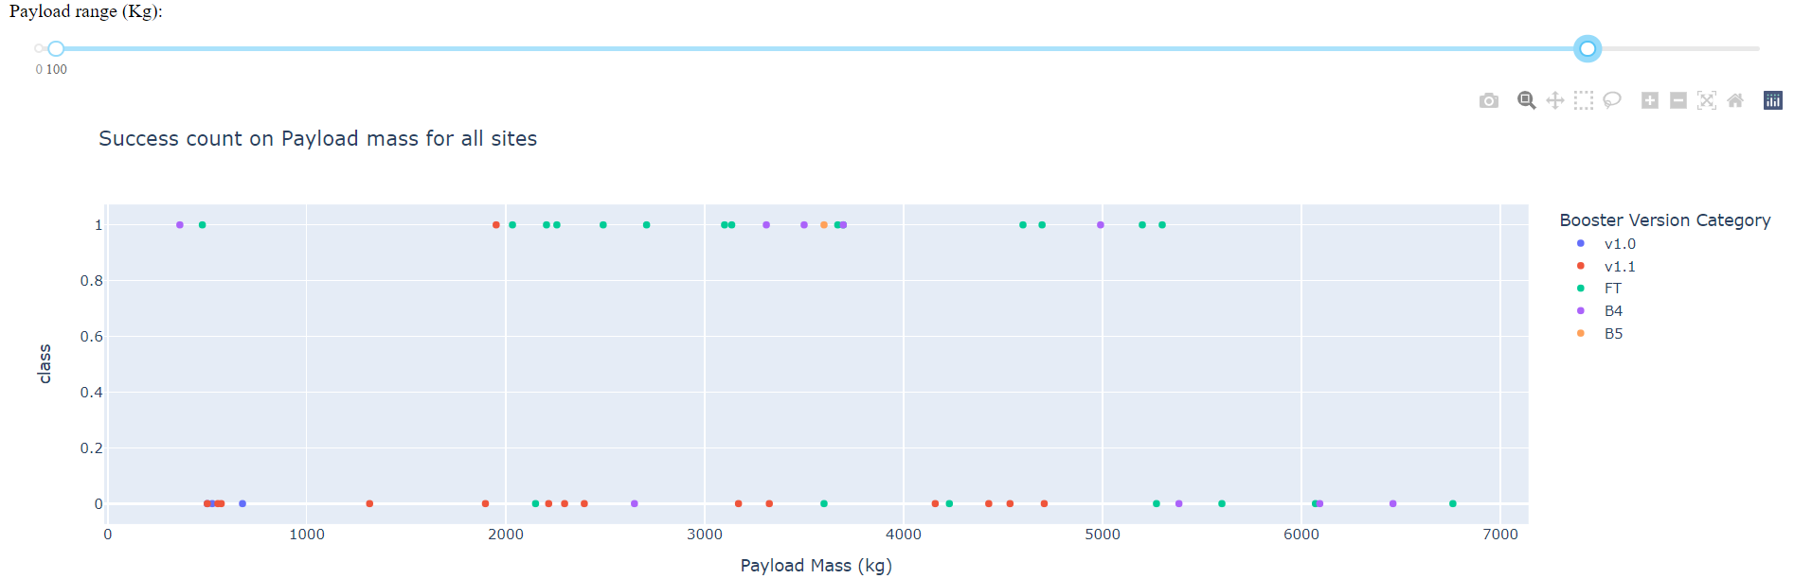
Payload vs. Launch Outcome
The FT booster type has the most successes, and those successes are concentrated in the 2000 to 4000 kg payload range
Explain the important elements and findings on the screenshot, such as which payload range or booster version have the largest success rate, etc.

Slide 42

Section 5

Slide 43
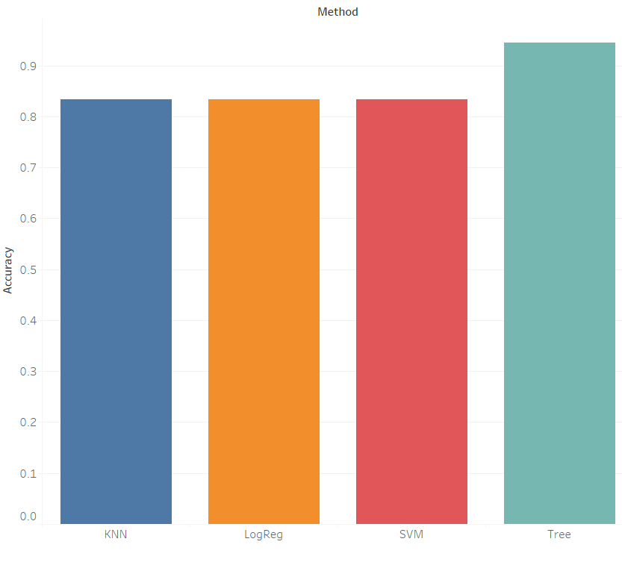
Classification Accuracy
The decision tree gives the highest out of sample accuracy of all the methods.

Slide 44
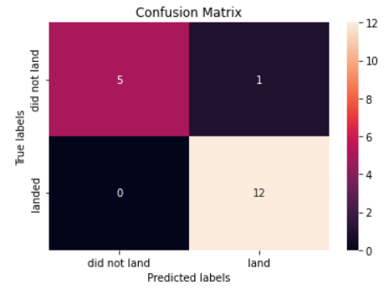
Confusion Matrix
The decision tree classification model gave an out-of-sample accuracy rate of 94%. The model only gave one false positive prediction as seen in this confusion matrix

Slide 45
Conclusions
It is possible to use data available online to predict which booster jets SpaceX will recover.
The highest out of sample prediction accuracy is produced by a decision tree prediction method.
Important features that predict a successful recovery is the type of orbit the rocket is sent in and the payload of the rocket.
SpaceX’s recovery rate increased overtime.

Slide 46
Appendix
Github repository can be found at https://github.com/parksandrecs/solid-dollop.git

Slide 47


